Slide 1
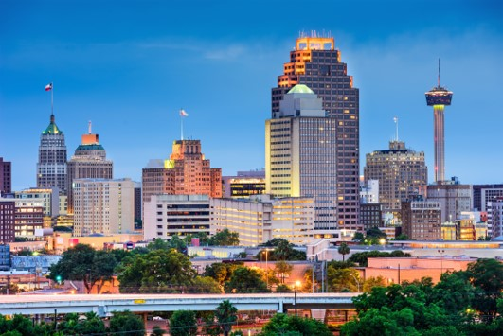

Outputs,
Outcomes & Impact
Engineering Research Center for
Sustainable Urban Communities

Slide 2
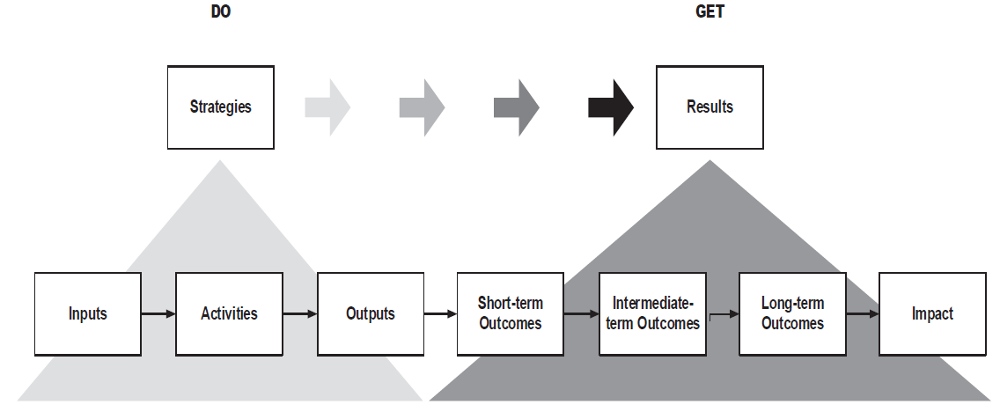
Simple Logic Model

Slide 3
Outputs vs. Outcomes and Impact
Our focus is here!
Activities you do or accomplish
Results due to the activities
Program Goal(s):, Testing and Referrals (CTR)
Inputs | Outputs |  | Expected Outcomes |  |  | Long-term Impact | Measurement Indicators
Resources | Activities | Participation | Short Term By End of Year 1 | Intermediate By End of Year 5 | Long Term By End of Year 10

Slide 4
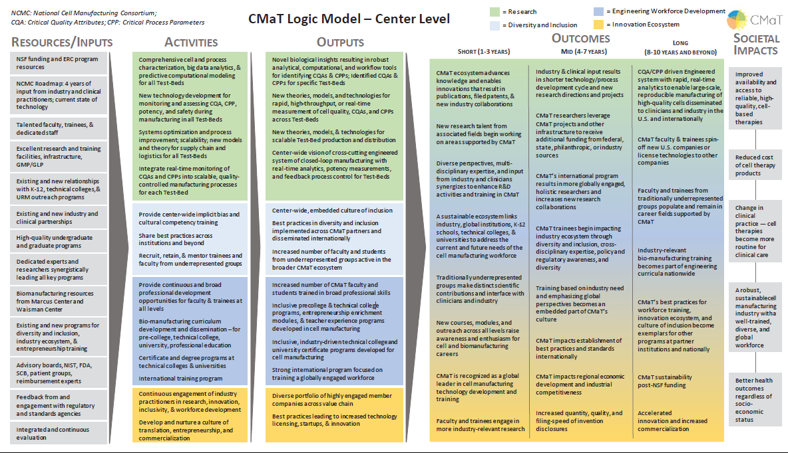

Slide 5
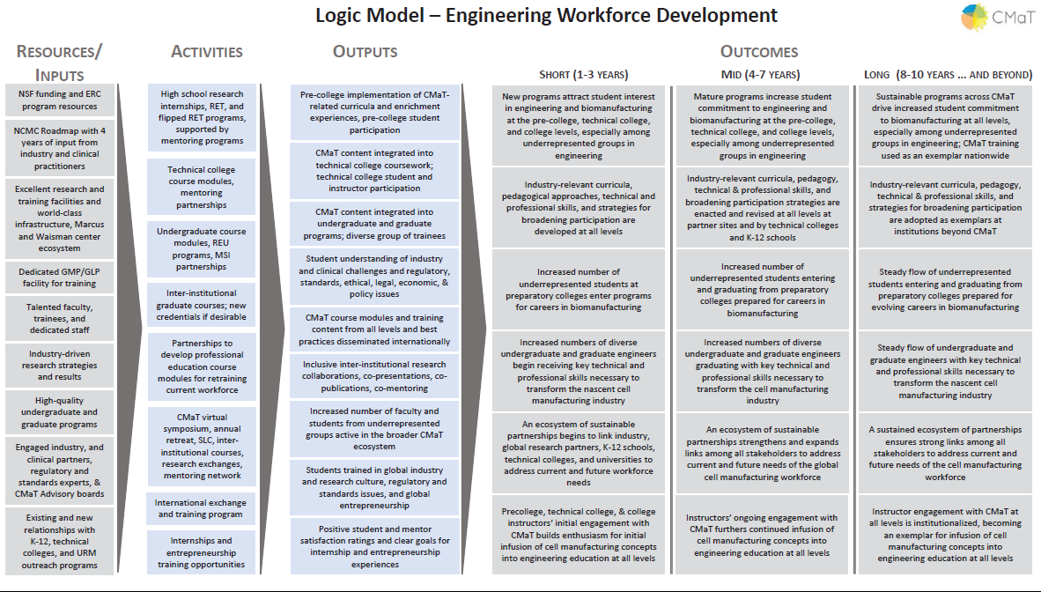

Slide 7
Outputs vs. Outcomes and Impact
Our focus is here!
Activities you do or accomplish
Results due to the activities
Program Goal(s):, Testing and Referrals (CTR)
Inputs | Outputs |  | Expected Outcomes |  |  | Long-term Impact | Measurement Indicators
Resources | Activities | Participation | Short Term By End of Year 1 | Intermediate By End of Year 5 | Long Term By End of Year 10

Slide 8
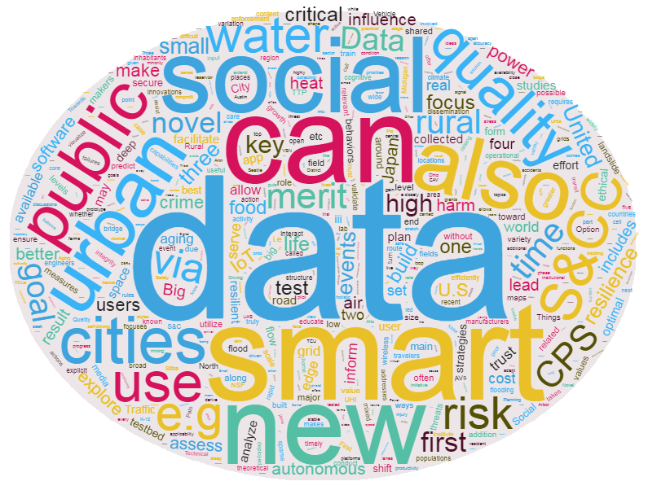
NSF Smart and Connected Community Awards

